Slide 1
Lecture 18
Bode Plot, High Pass Filter, Series Resonance

Slide 2
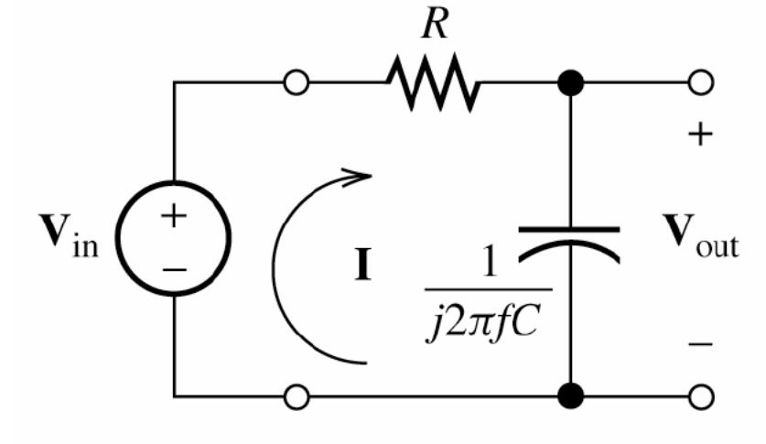
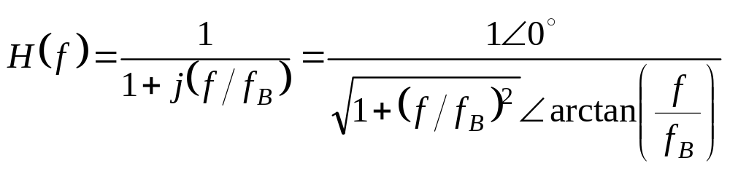
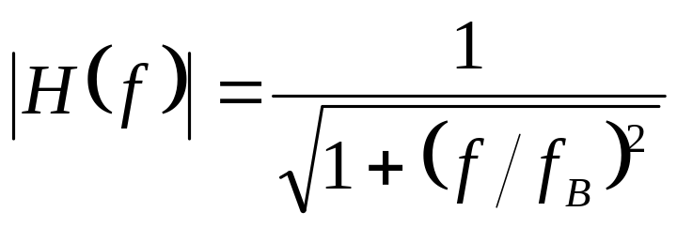
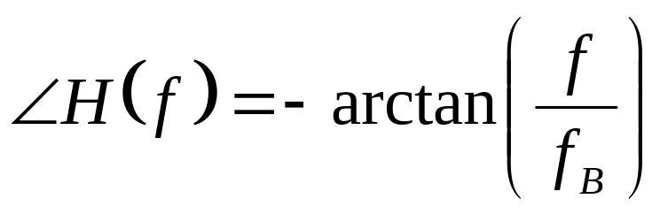
First-Order Low Pass Filter

Slide 3
Bode Plot for a First-Order Low-Pass Filter
A Bode plot shows the magnitude of a network function in decibels versus frequency using a logarithmic scale for frequency.

Slide 4
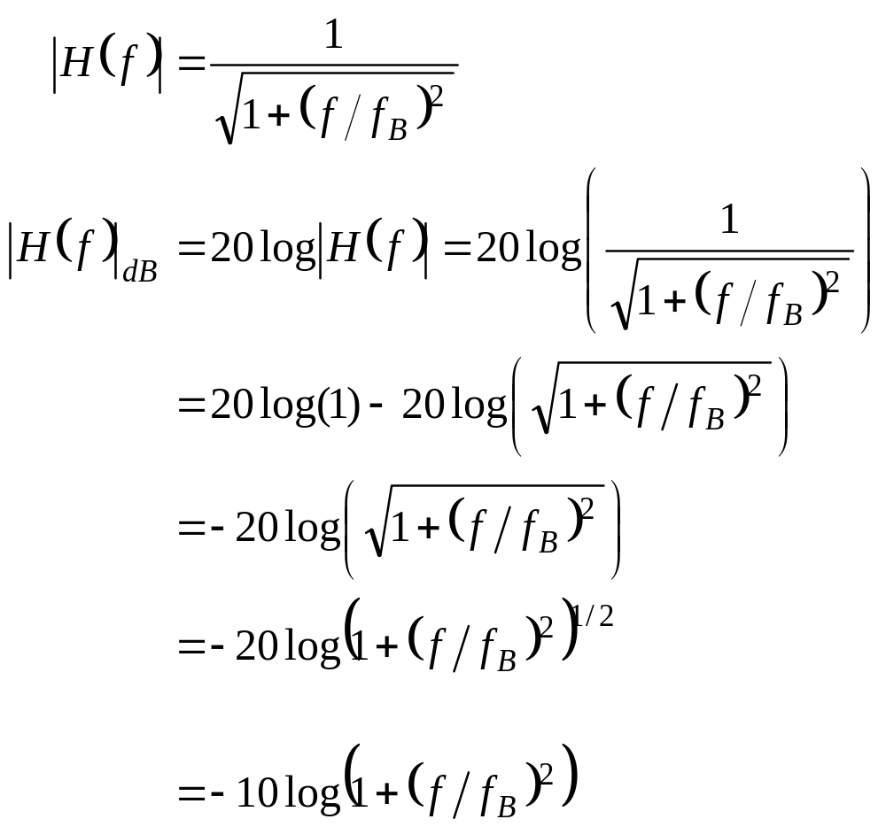
Bode Plot for a First-Order Low-Pass Filter

Slide 5
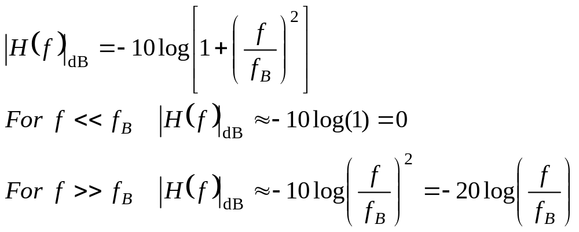
Asymptotic Behavior of Magnitude for Low and High Frequencies

Slide 6
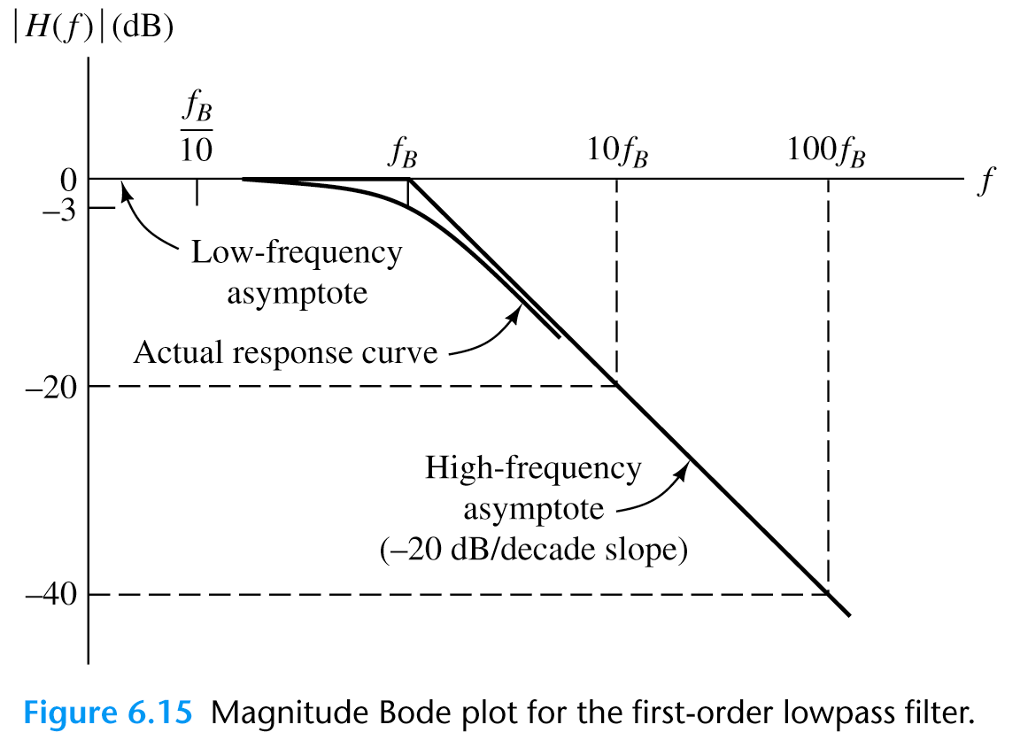
Magnitude Bode Plot for First-Order Low Pass Filter

Slide 7
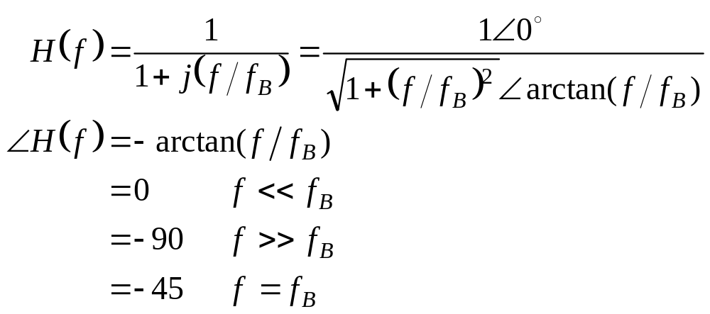
Asymptotic Behavior of Phase for Low and High Frequencies

Slide 8
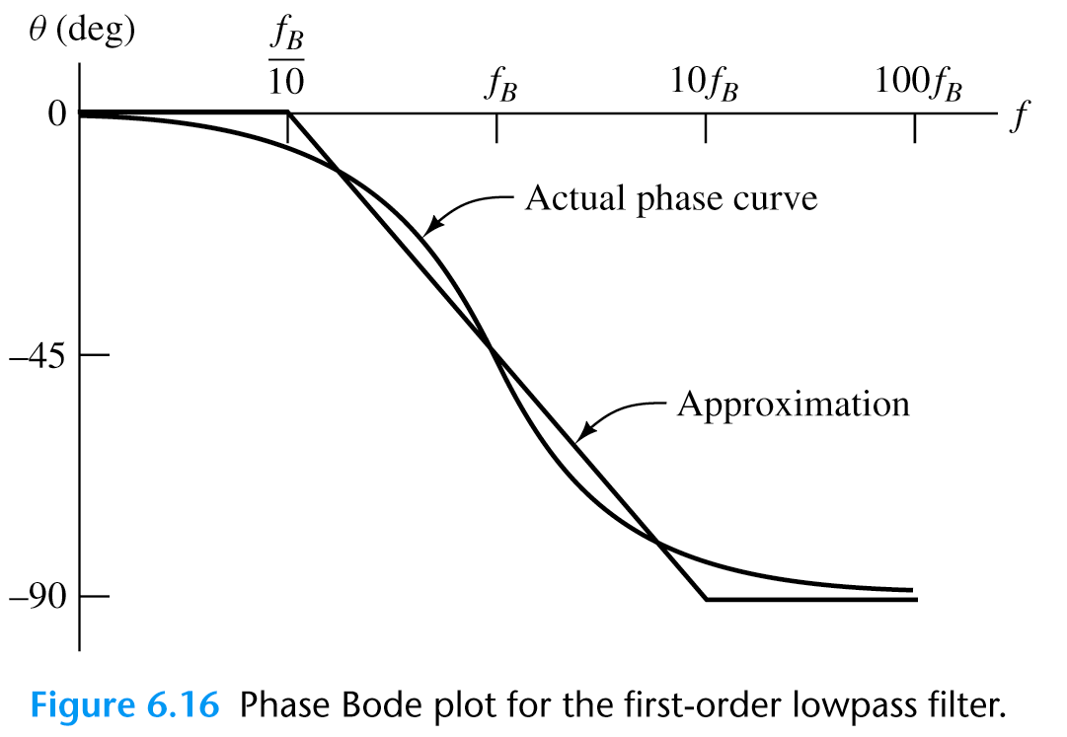
A horizontal line at zero for f < f_{B} /10.
2. A sloping line from zero phase at f_{B} /10 to –90° at 10f_{B}.
3. A horizontal line at –90° for f > 10f_{B}.

Slide 9
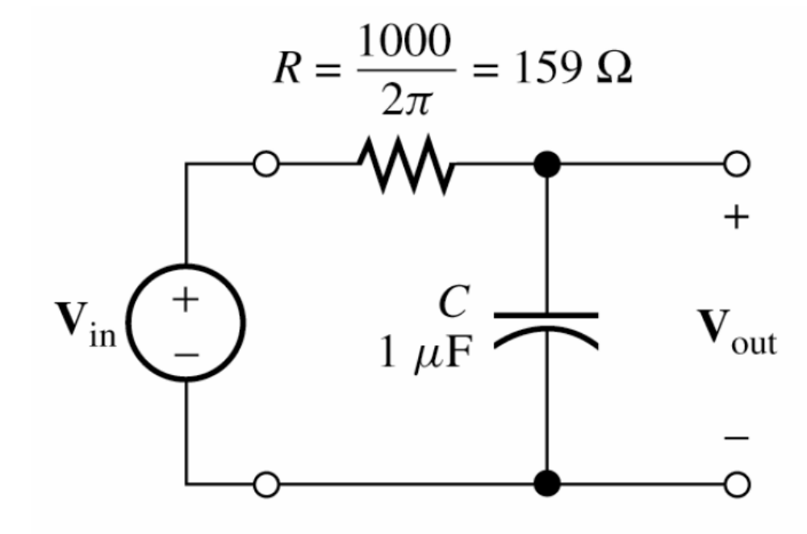
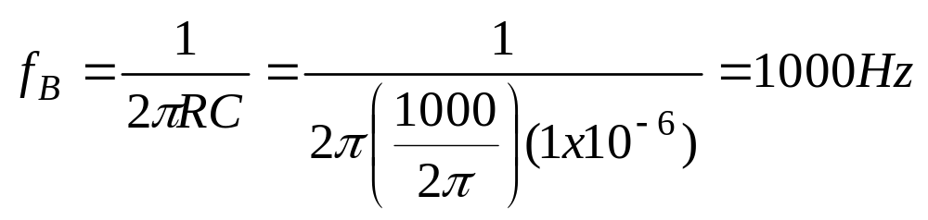
Exercise 6.11
Sketch the Bode plots for the low-pass filter shown above:

Slide 10
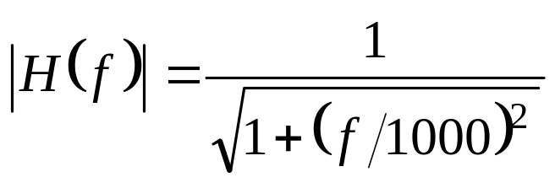
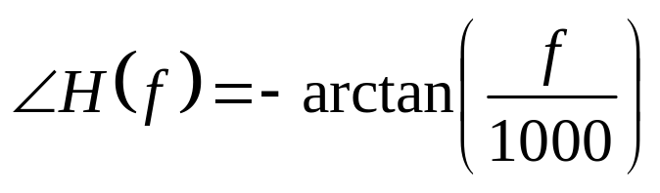
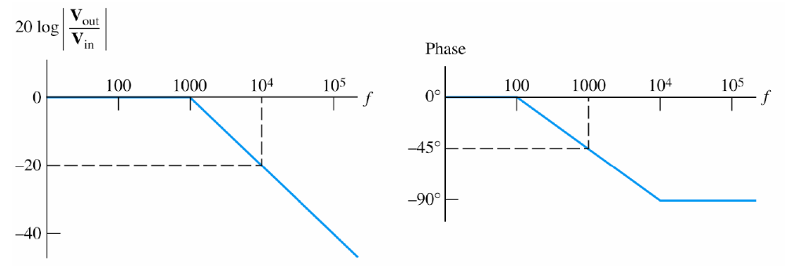
Exercise 6.11

Slide 11
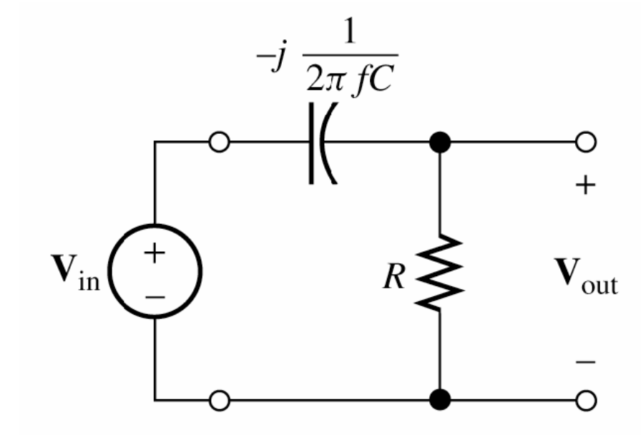
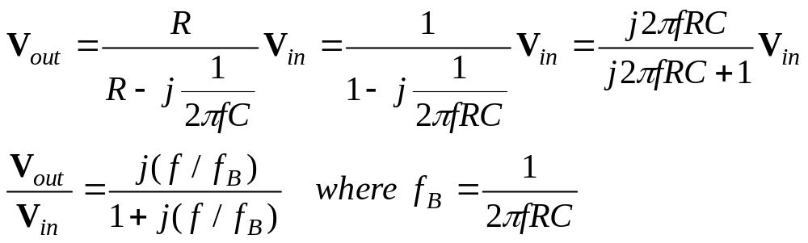
First-Order High-Pass Filter

Slide 12
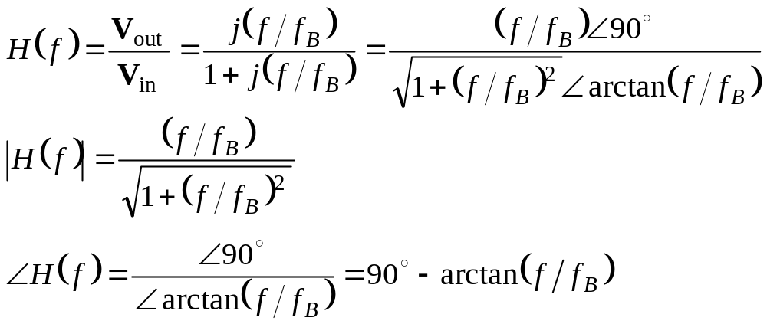
First-Order High-Pass Filter

Slide 13
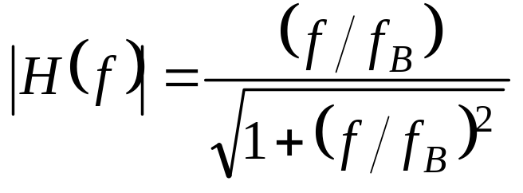
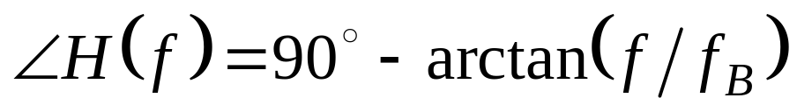
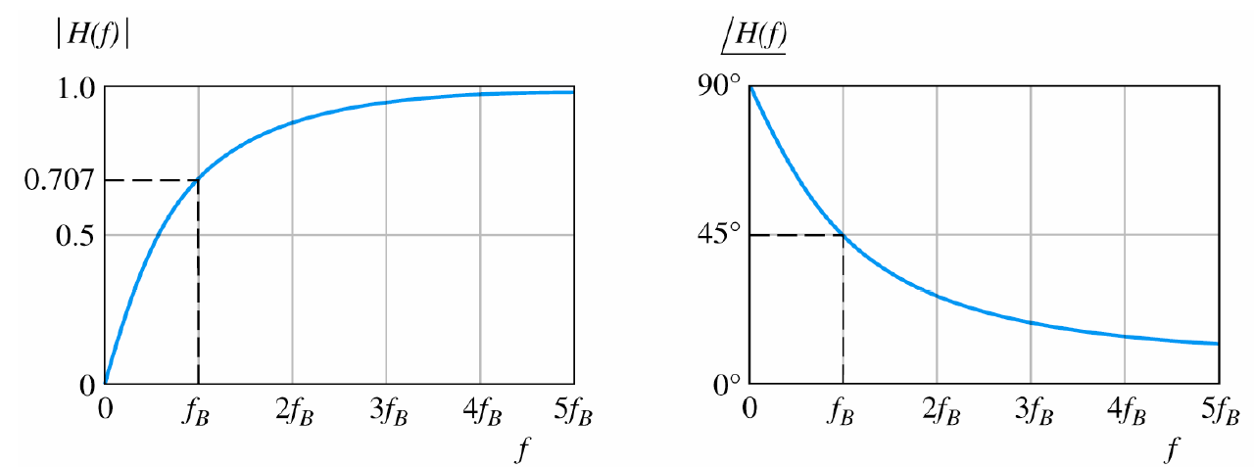
First-Order High-Pass Filter

Slide 14
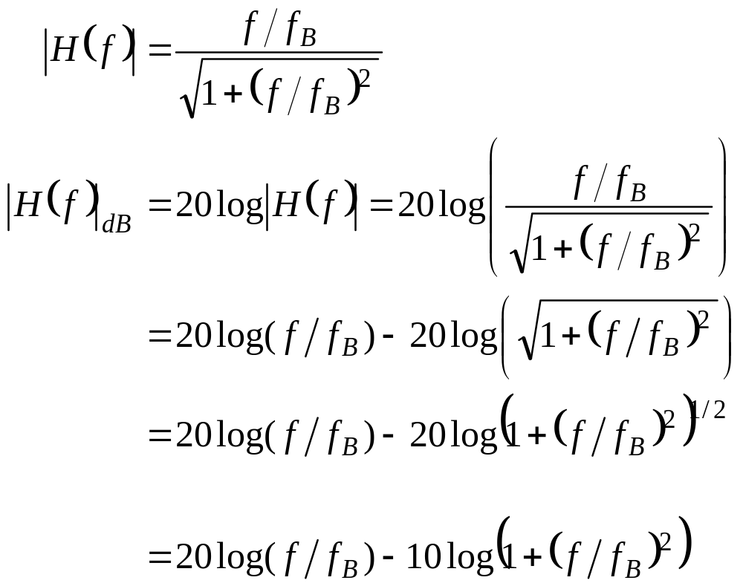
First-Order High-Pass Filter

Slide 15
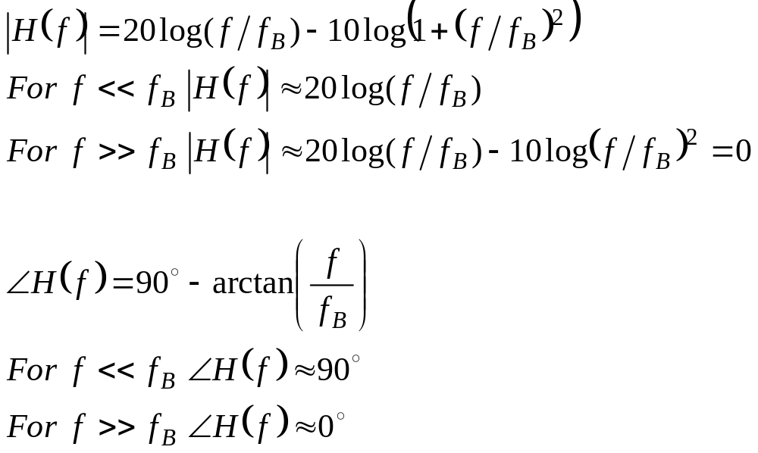
Asymptotic Behavior of First-Order High-Pass Filter

Slide 16
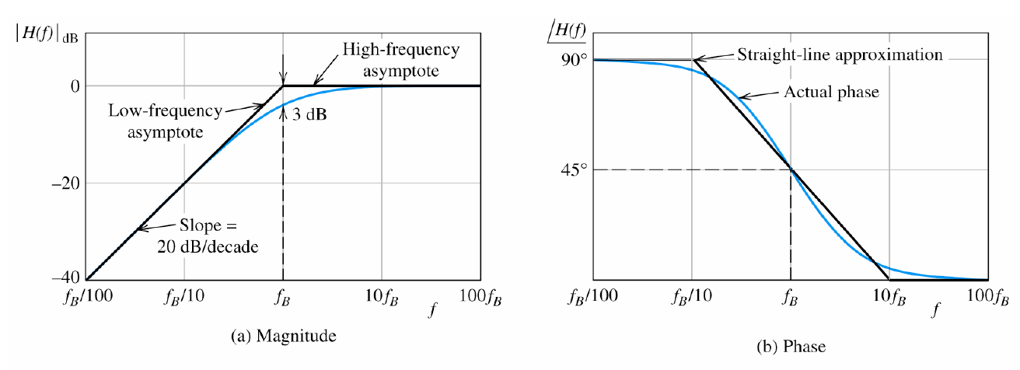

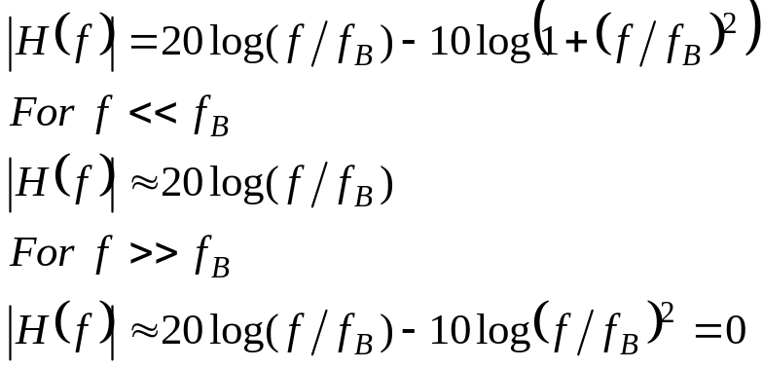
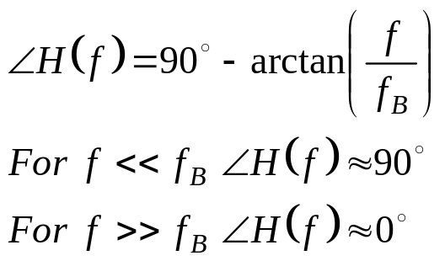
Bode Plots for the First-Order High-Pass Filter

Slide 17
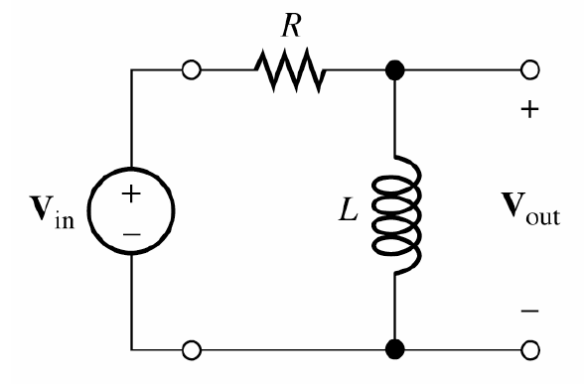
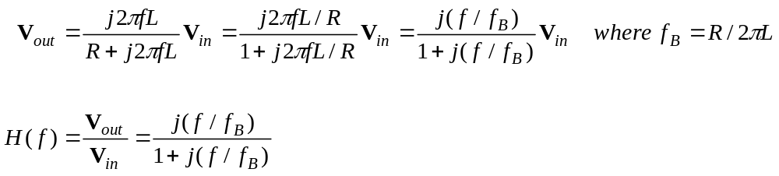
Exercise 6.13
Find the transfer function for this circuit:

Slide 18
Exercise 6.14
R=1kΩ
Find the half power frequency and the capacitance for a high-pass filter that reduces the amplitude of a frequency component at 1 kHz by 50dB

Slide 19
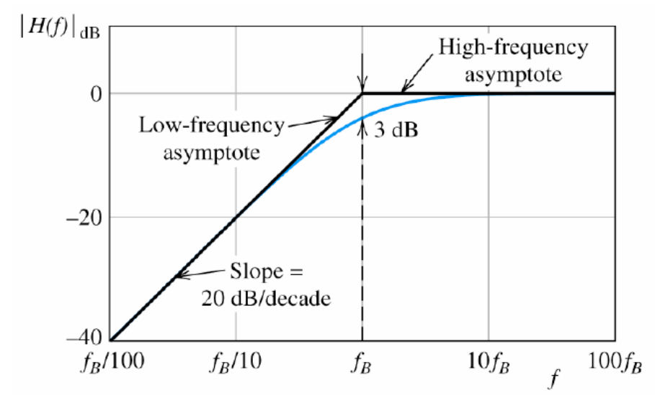
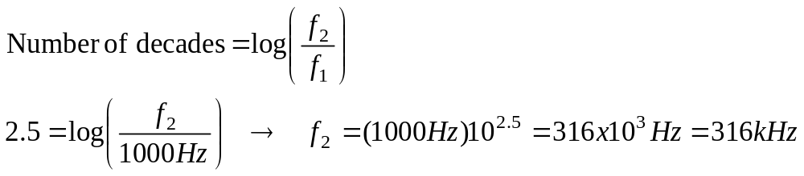
Exercise 6.14
What half-power frequency f_{B} is 2.5 decades above 1 kHz?

Slide 20
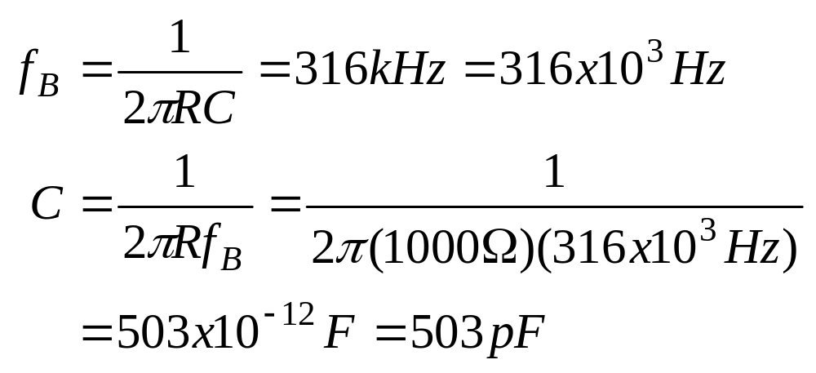
Exercise 6.14

Slide 21
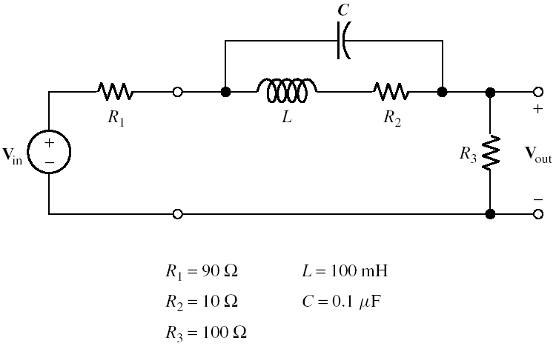
Computer-Generated Bode Plot

Slide 22
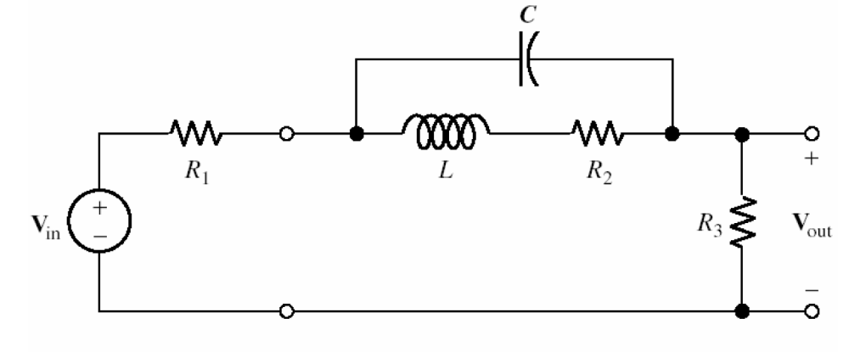
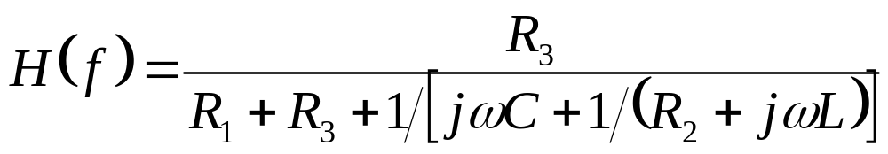
Computer-Generated Bode Plot
Check the low and high frequency behavior to make sure the computer generated Bode plot is correct

Slide 23
Low Frequency Behavior
At low frequency the inductance is a short circuit
The capacitance is an open circuit

Slide 24
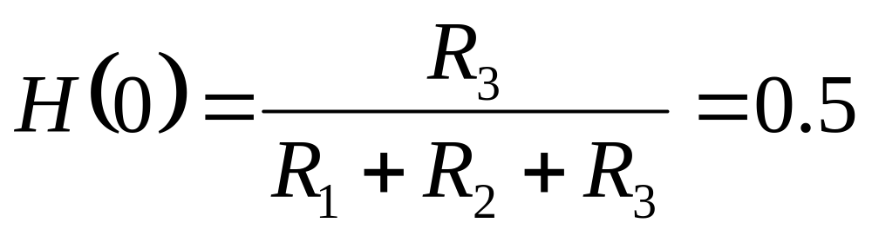
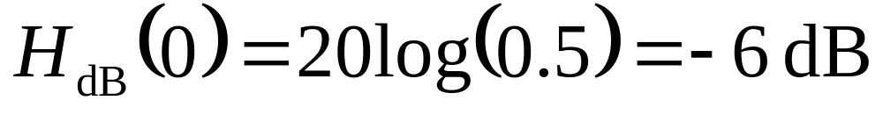
Low Frequency Behavior

Slide 25
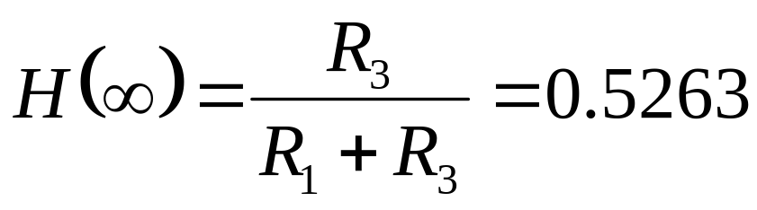
High Frequency Behavior
At high frequency the inductance is an open circuit
The capacitance is a short circuit

Slide 26
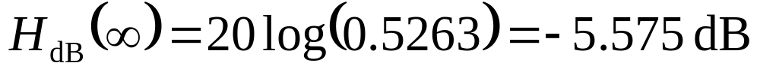
High Frequency Behavior

Slide 27
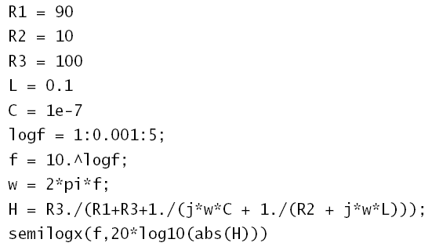
MATLAB Code

Slide 28
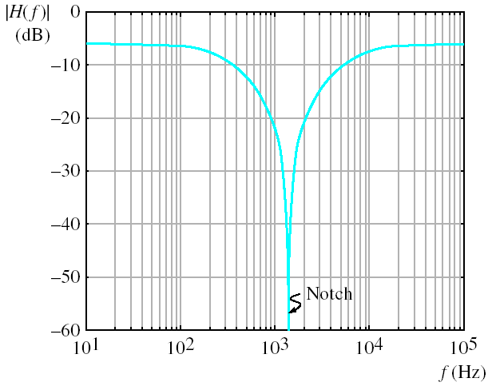
MATLAB Output

Slide 29

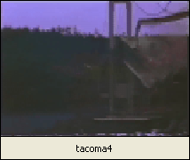
Resonance
Resonance is a phenomenon that can be observed in mechanical systems and electrical circuits.

Slide 30
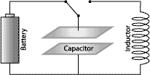
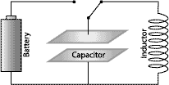
Series Resonance
http://www.intuitor.com/resonance/circuits.html

Slide 31
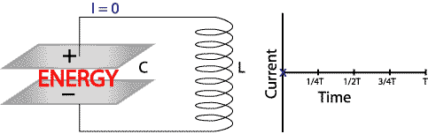
Series Resonance
http://www.intuitor.com/resonance/circuits.html

Slide 32
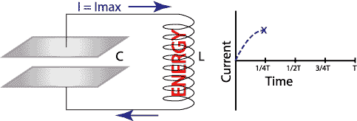
Series Resonance
http://www.intuitor.com/resonance/circuits.html

Slide 33
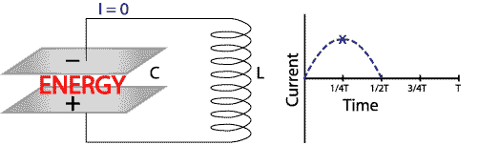
Series Resonance
http://www.intuitor.com/resonance/circuits.html

Slide 34
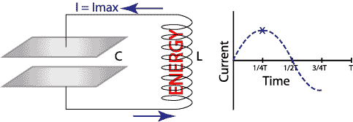
Series Resonance
http://www.intuitor.com/resonance/circuits.html

Slide 35
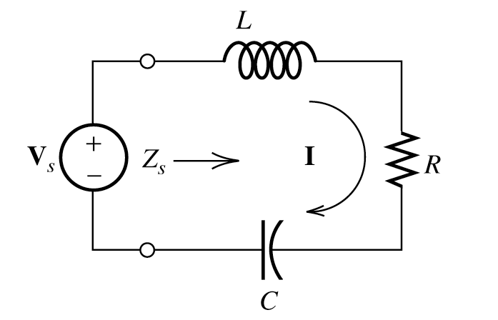
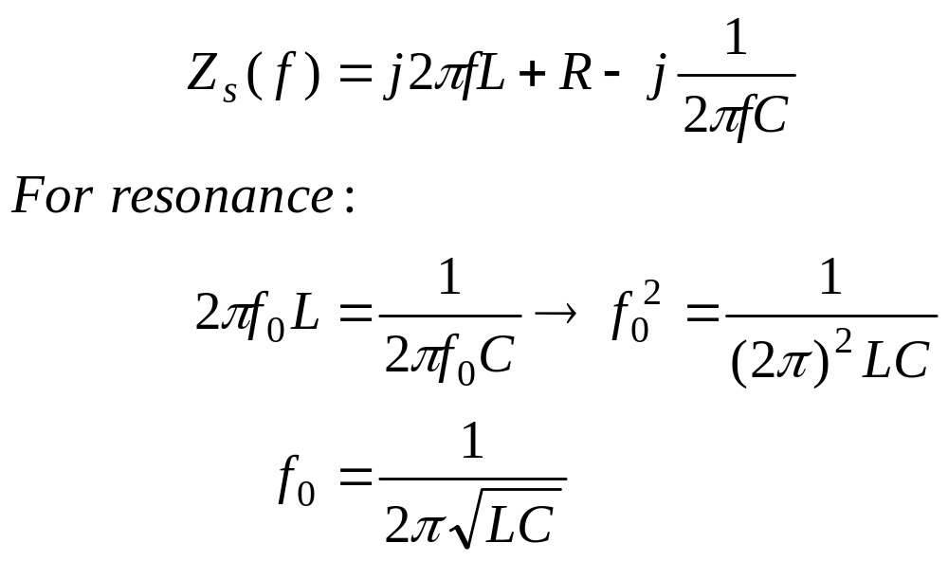
Series Resonance
For resonance the reactance of the inductor and the capacitor cancel:

Slide 36
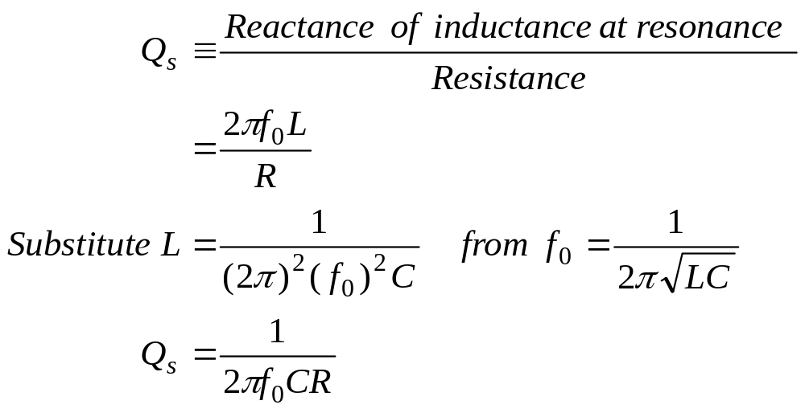
Series Resonance
Quality factor Q_{S}

Slide 37
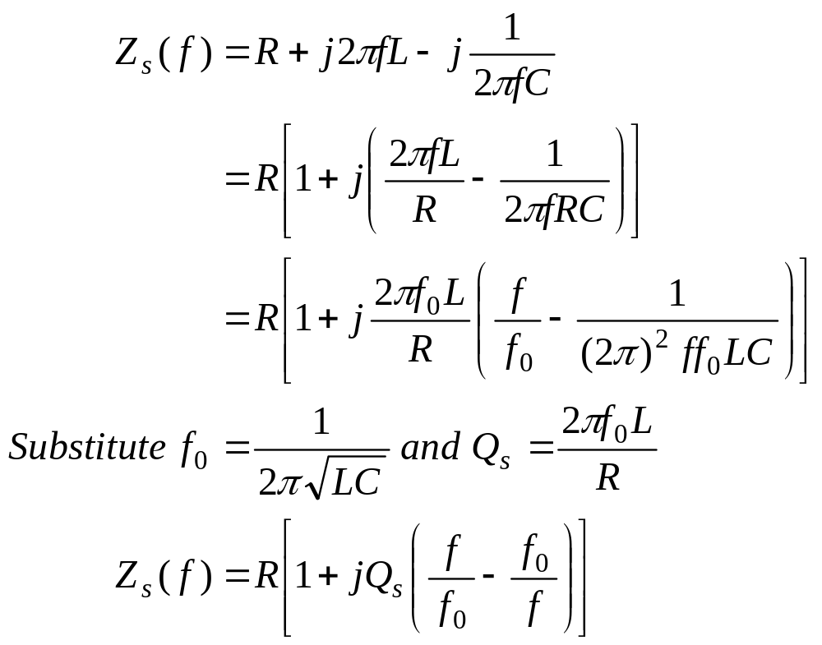
Series Resonance

Slide 38


Series Resonance

